Slide 1
Project Proposal
By Team
Unattached and Unhinged
Cloud Computing
09/16/2025
Team member 1: Varad Paradkar (801418318)
Team member 2: Mitali Yadav (801453849) Team member 3: Sudeepta Bal(801455628)
Team member 4: Ruthwik Dovala(801431661)

Slide 2
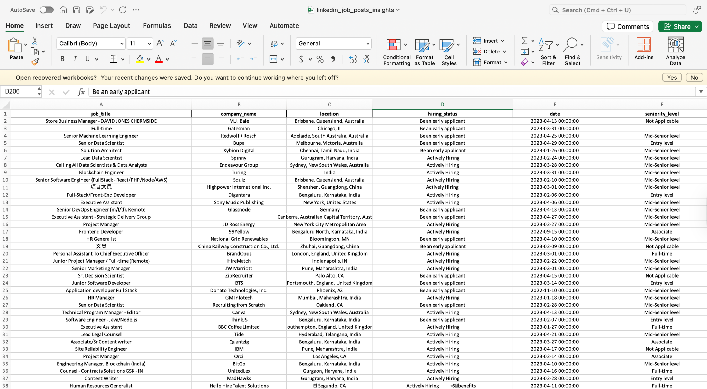
Progress so far
Cloud Computing
09/16/2025
The project group has been formally established and is prepared to begin collaborative work.
The team has decided to work with a job-related dataset as the focus, to be compiled through web scraping from LinkedIn and a startup-oriented job platform.
An initial sample dataset has been acquired to support demonstration activities and preliminary testing.

Slide 3
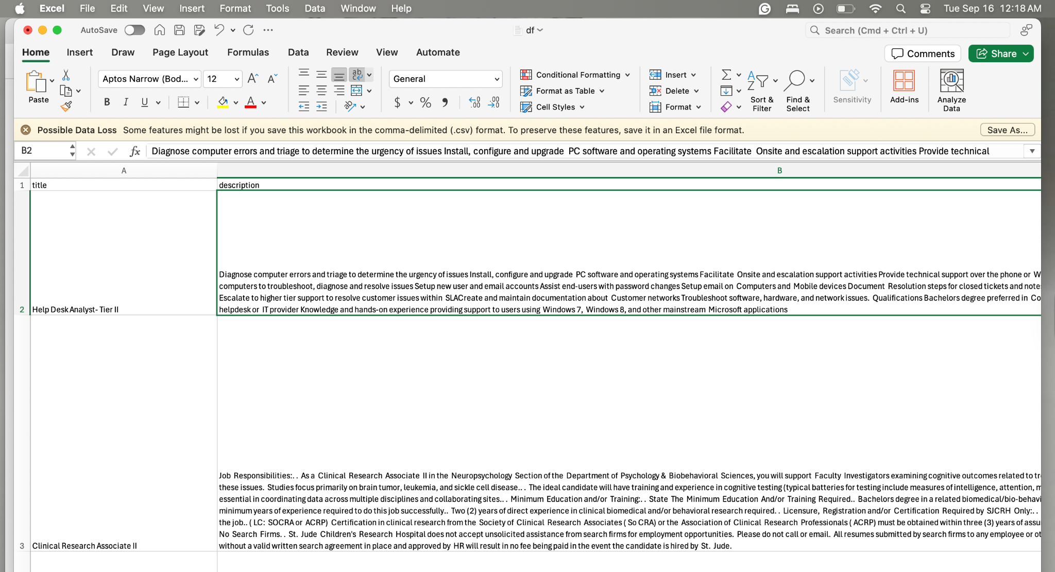
Current Challenges
Cloud Computing
09/16/2025
Ongoing efforts are focused on enhancing the scraper to capture the latest job postings from LinkedIn and Y Combinator.

Slide 4
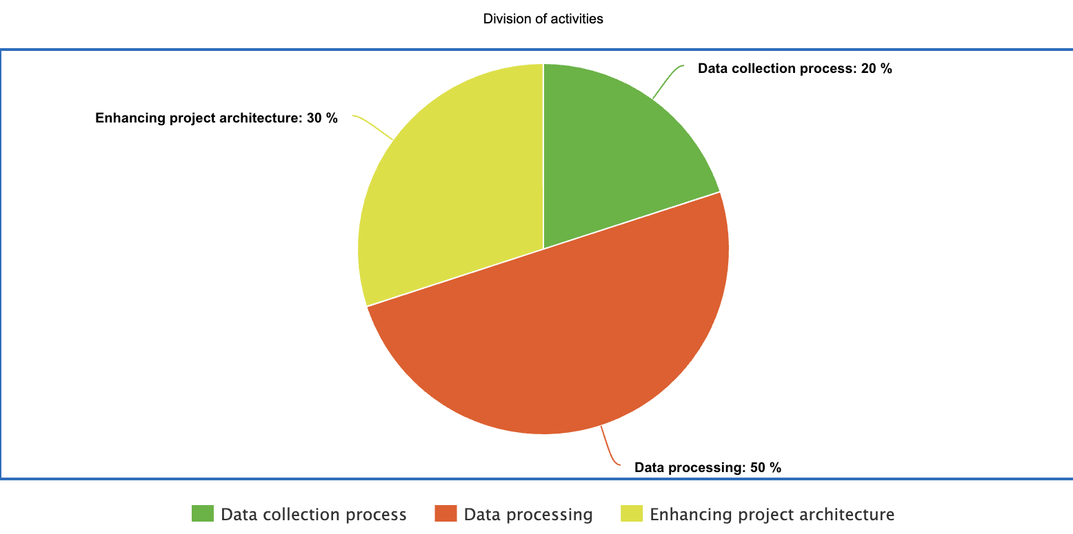
Next Week activities
Cloud Computing
09/16/2025
To complete the data collection process and finalize job filtering criteria, including country and role specifications.
To process the collected data by implementing ingestion and cleaning workflows using Spark.
To enhance and document the end-to-end project architecture to validate the design and ensure clarity for each component.

Slide 5
Motivation, Analytics & Prediction
Cloud Computing
09/16/2025
As upcoming graduates, we are entering a highly dynamic and competitive job market. Through this project, we aim to gain valuable insights into current employment trends and better understand the evolving landscape.
Our goal is to build a comprehensive data pipeline to generate insights into the current job market.
Using Spark SQL, we will analyze key trends such as hiring companies, high-demand locations, and sought-after roles and skills.
Additionally, we will implement real-time monitoring of new job postings and train MLlib models to classify jobs by industry and role specialization.

Slide 6
Dataset acknowledgement (Dataset can be improved or changed further)
Cloud Computing
09/16/2025
Linkedin_job_posts_insights: https://www.kaggle.com/datasets/sindhumadhurii/linkedin-job-posts-insights-dataset
Linkedin data Job Titles and Postings:
https://www.kaggle.com/datasets/tianyimasf/linkedin-data-job-titles-and-postings

Slide 7
Thank You!
Cloud Computing
09/16/2025

